Slide 1

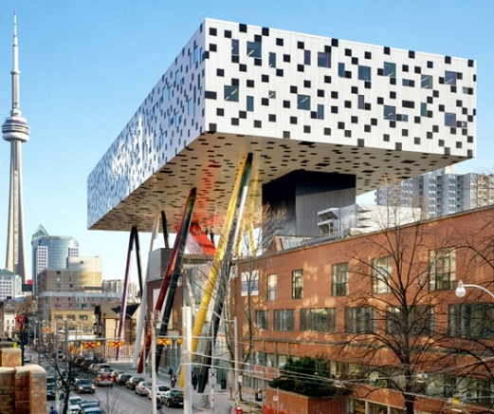

The Inclusive Design Research Centre
25th Anniversary
Open before ‘open’
2

Slide 2
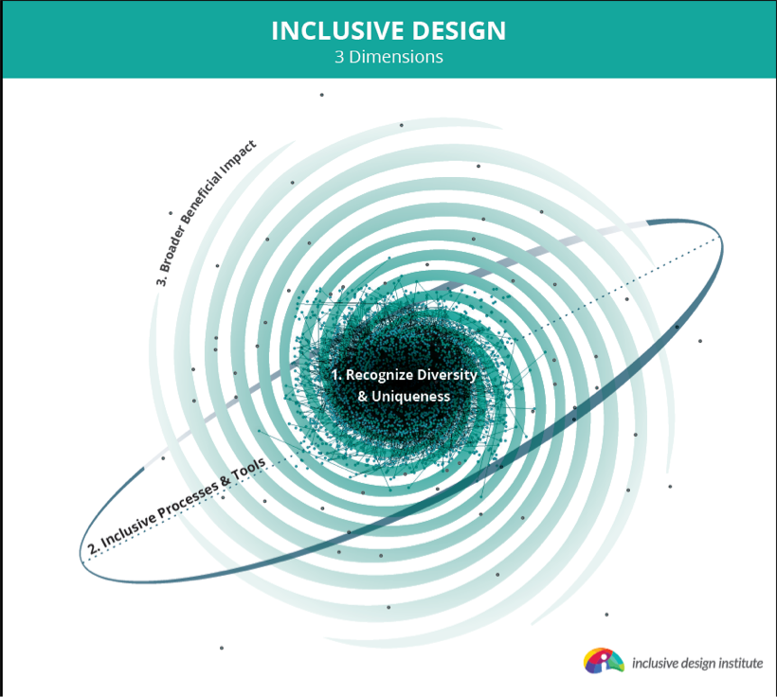

Slide 3


Slide 4
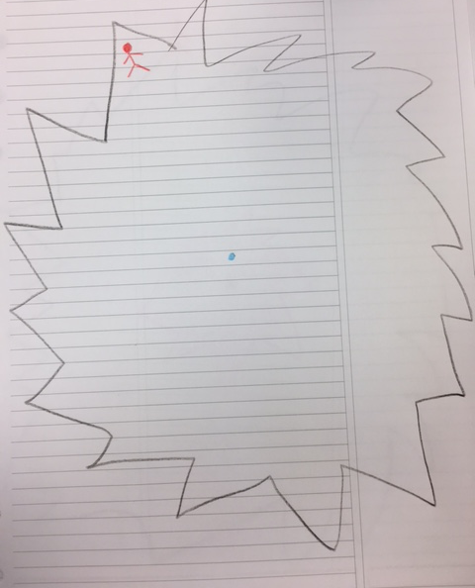
The view from the edge
The most to lose
The most to gain
The most at risk
The greatest vulnerability
The most compelling uses

Slide 5
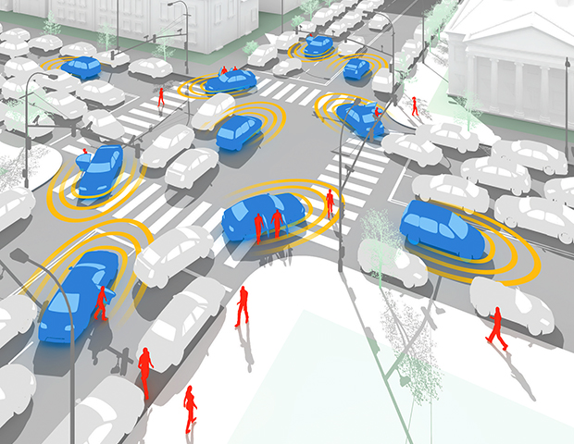
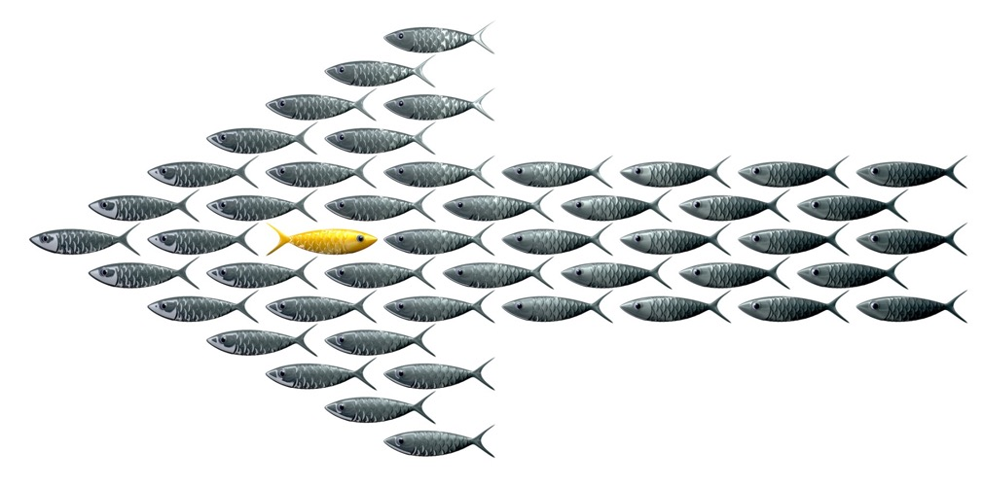
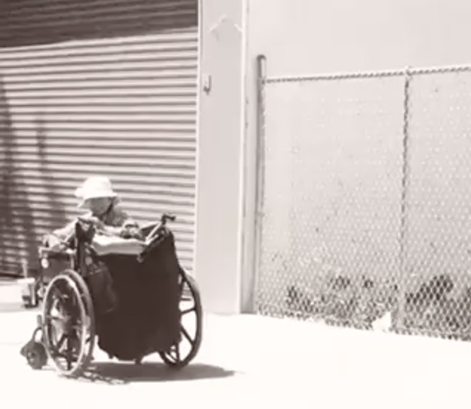
Alice and the unexpected…

